Slide 1




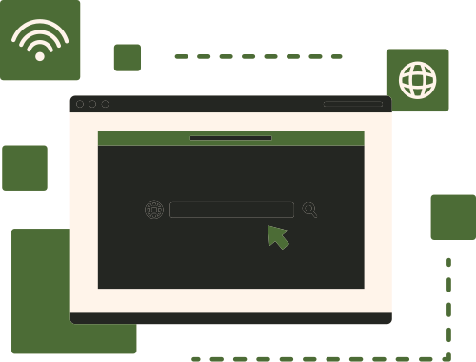
LIBRARY
MIS
Improving Library Operations Through MIS

Slide 2

What is Library MIS?
Definition
Goal
Reducing the time on searching books and the time in-time out in the library
A system that helps library operations

Slide 3
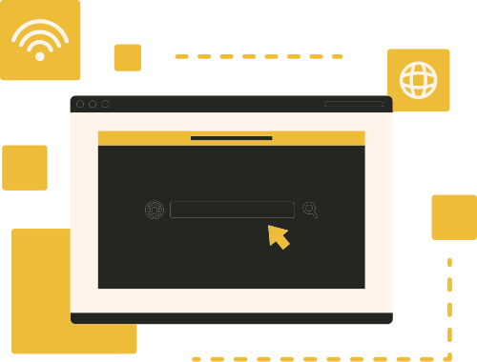


Benefits of Using Library MIS
Access to Information
Find quality information.
Better managing informations
Reduces errors common in paper-based system
Reduces time spent on searching books
Quickly tracks the availability of the books

Slide 4

Features Of The Library MIS
Time in/ Time out
Records the student entry and exit for monitoring and security purposes
Centralized Database
Stores all the library books in one system for faster access and managemenrt
Search Functionality
Allow users to search books by ID, keyword, author, or genre

Slide 5

Primary Objectives
1
2
3
Improve Efficiency
Interactive System
Accurate and reliable library data management

Slide 6

Functional Requirements
  The system shall store complete books information
  The system shall allow the librarian to edit
Book Management
01
Search Functionality
  The system shall allow users to search books by Book ID, keyword, or genre
02
Attendance Monitoring
  The system shall record library attendance through time in/time out
03

Slide 7
Non-Functional Requirements
Performance
01
Fast system response
Availability
02
System accessible all the time
Reliability
03
Accurate and consistent data

Slide 8

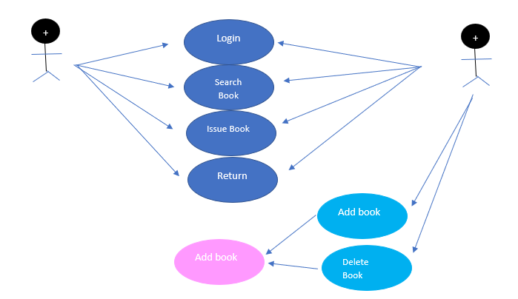
Use Case Diagram
Librarian
Student

Slide 9
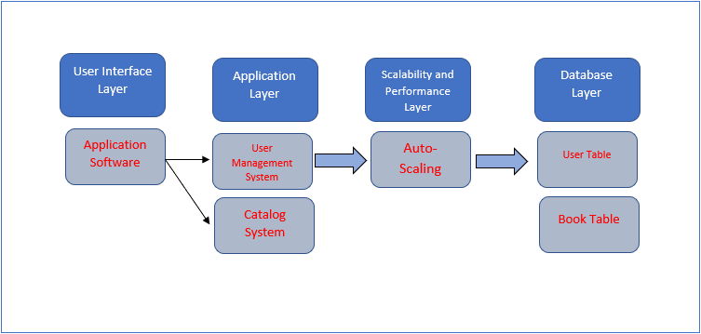
High Level Design

Slide 10
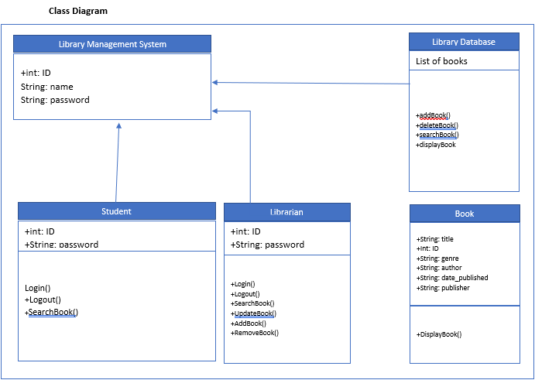
Unified Modeling Language

Slide 11
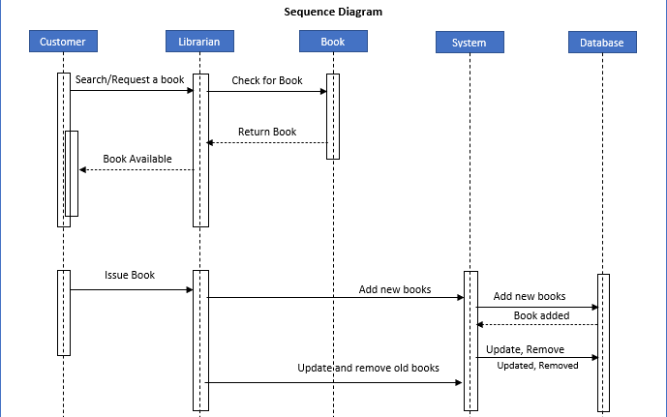
Sequence Diagram

Slide 12
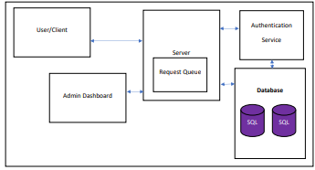
Low Level Design

Slide 13
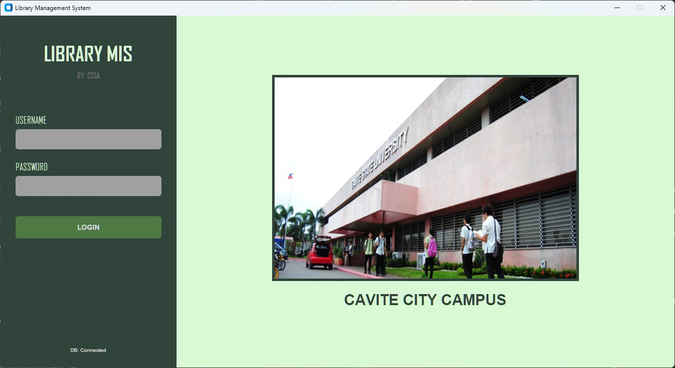
System Interface Design

Slide 14
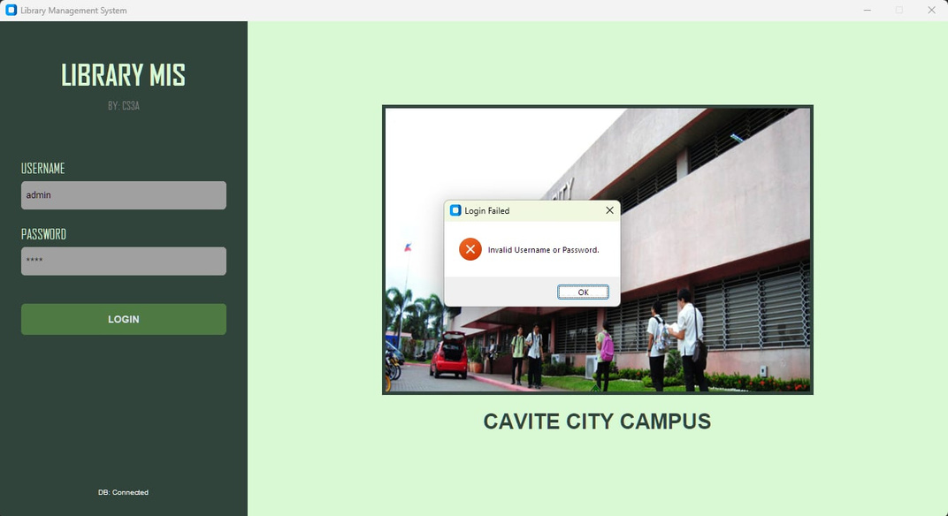
System Interface Design

Slide 15
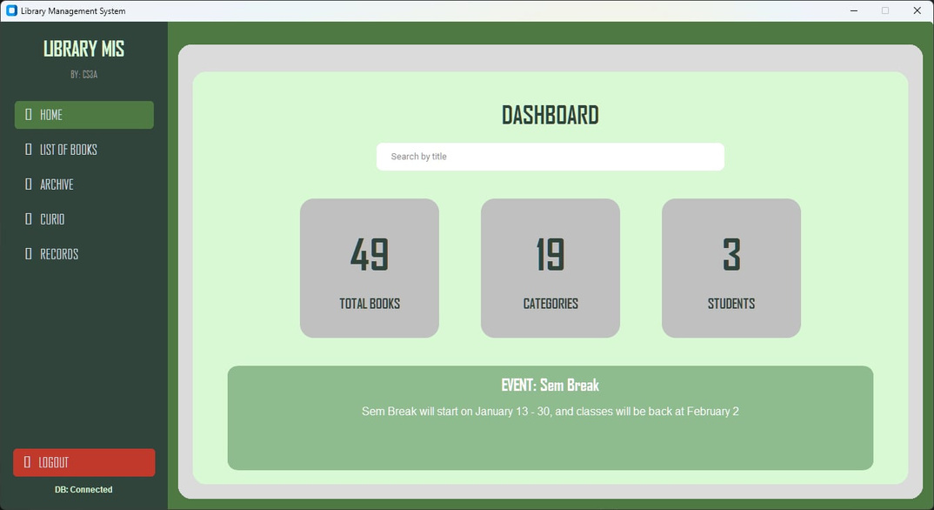
System Interface Design

Slide 16
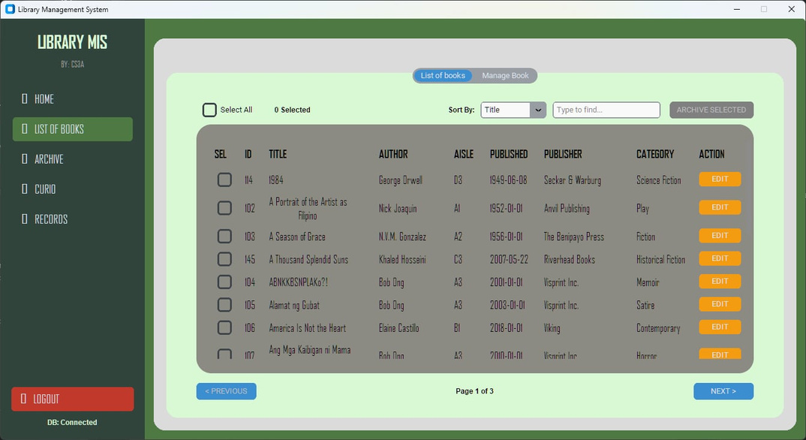
System Interface Design

Slide 17
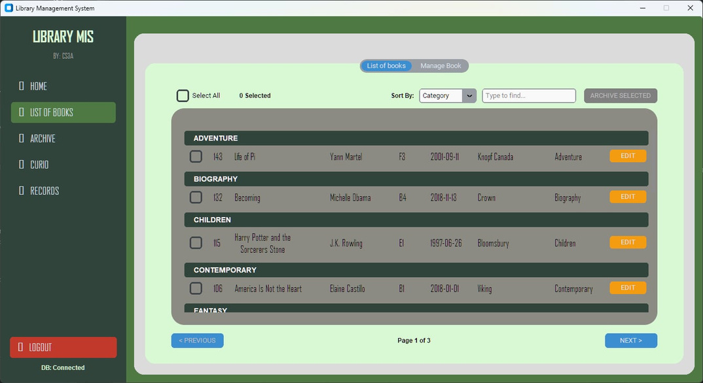
System Interface Design

Slide 18
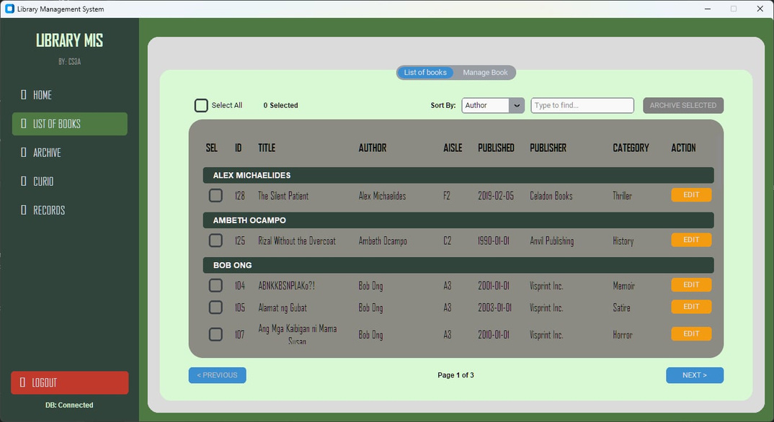
System Interface Design

Slide 19
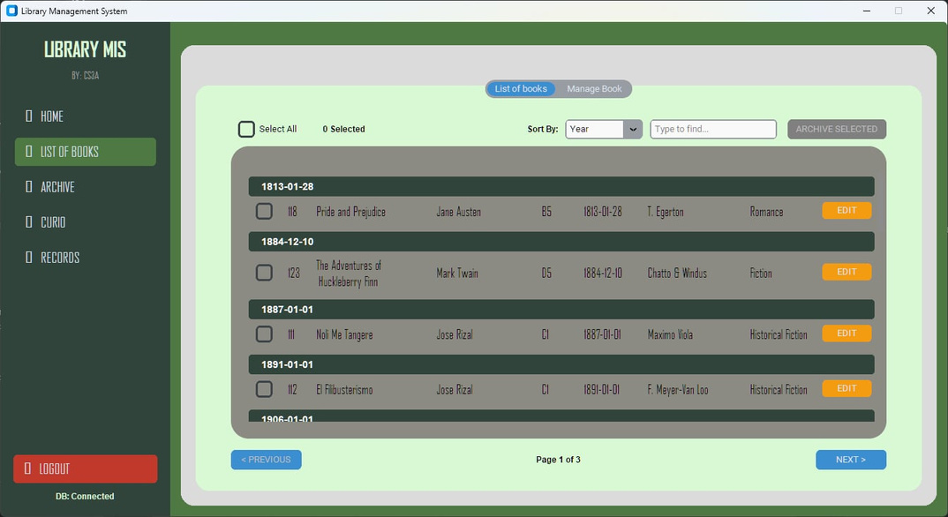
System Interface Design

Slide 20
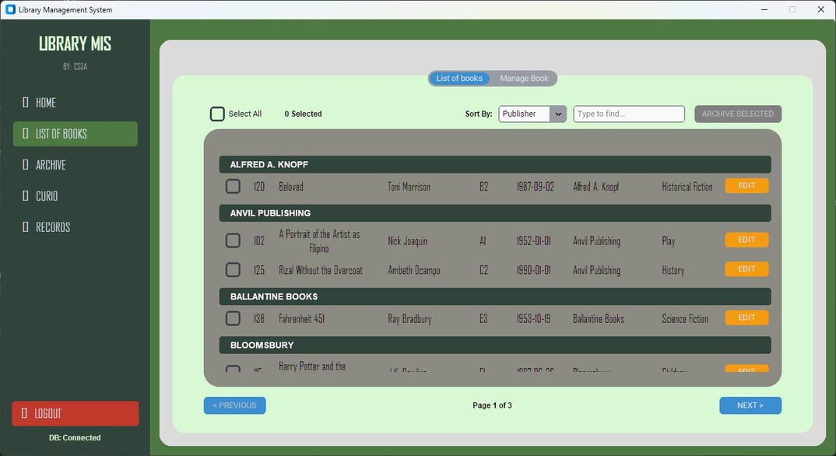
System Interface Design

Slide 21
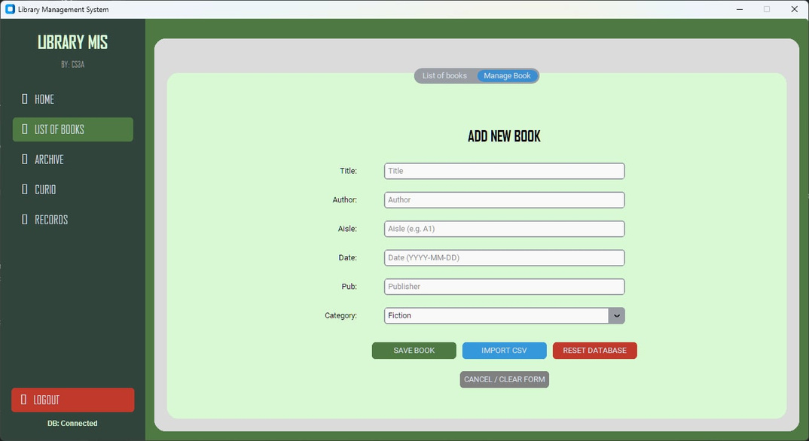
System Interface Design

Slide 22
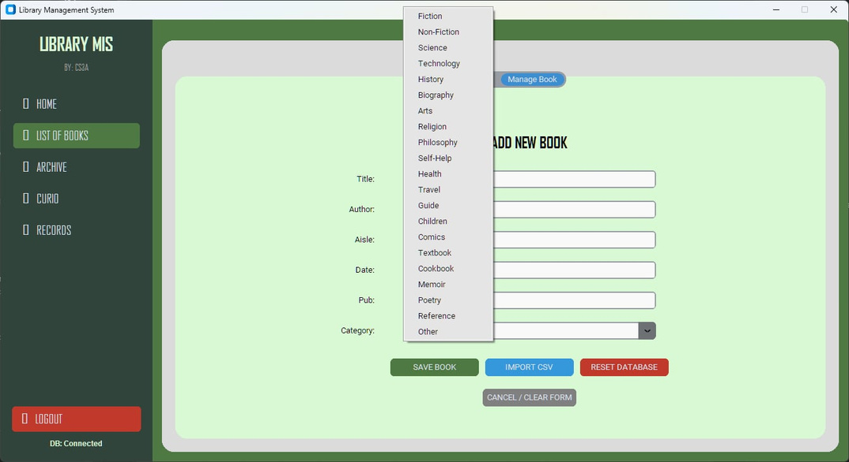
System Interface Design

Slide 23
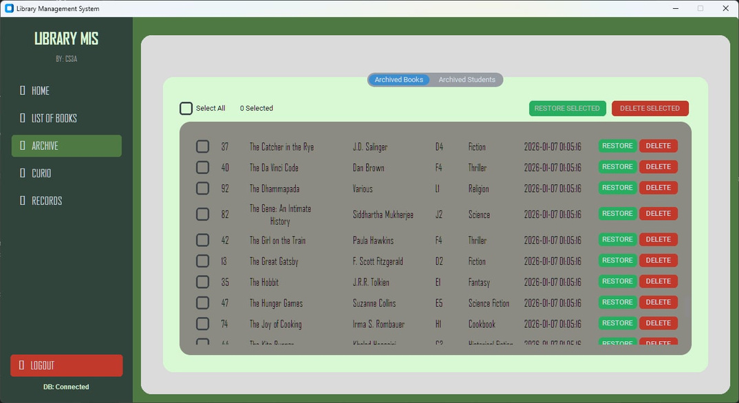
System Interface Design

Slide 24
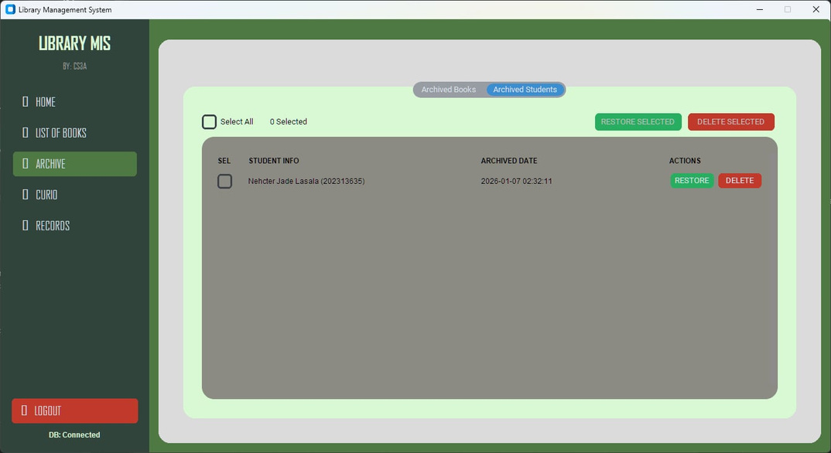
System Interface Design

Slide 25
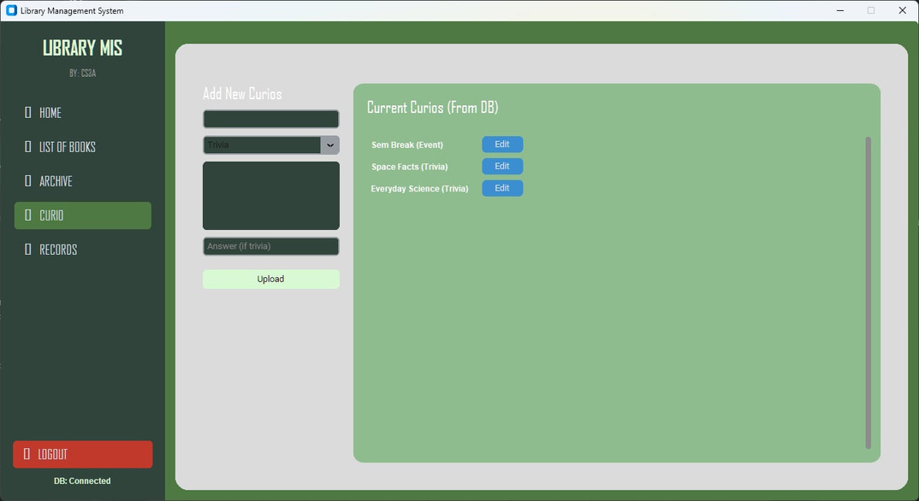
System Interface Design

Slide 26
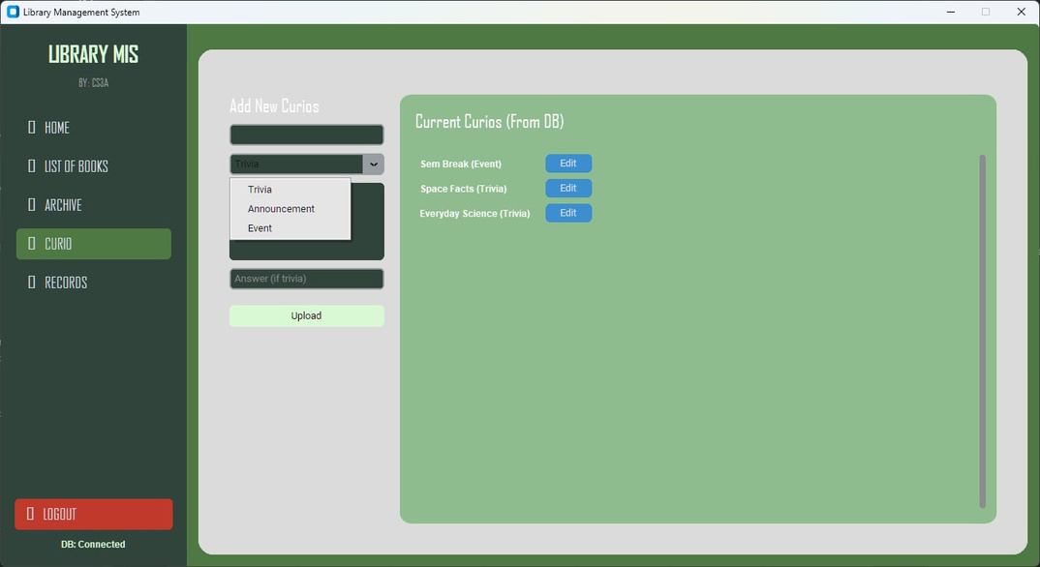
System Interface Design

Slide 27
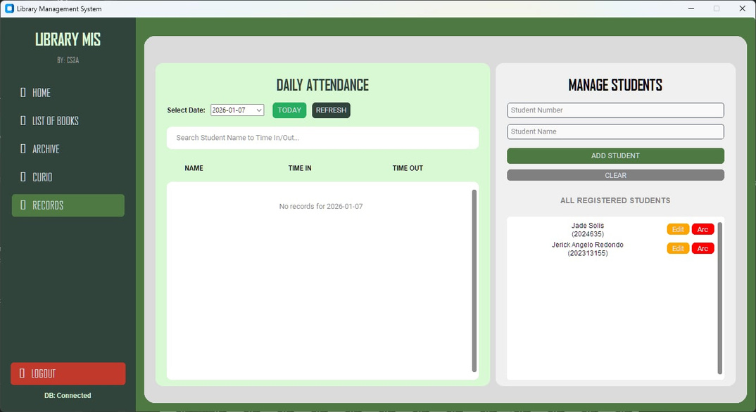
System Interface Design

Slide 28
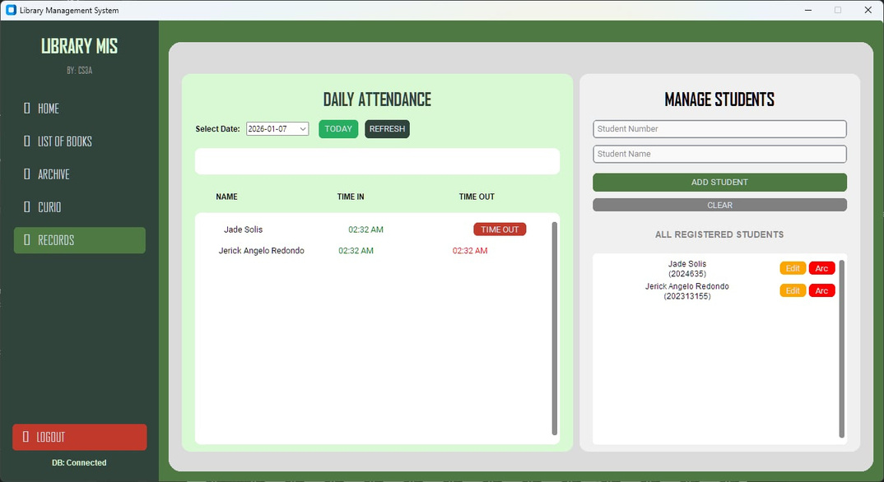
System Interface Design

Slide 29


Conclusion
In conclusion, the Library Management Information System (MIS) streamlines book searches and check-in/check-out processes with features like a user-friendly interface and real-time tracking, enhancing both staff efficiency and user satisfaction. The "Curio" feature adds engaging announcement, event and trivia, making the library experience more interactive and encouraging exploration.

Slide 30
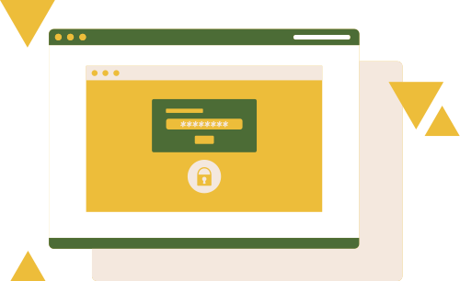
PRESENTED BY:
HENDRIX, NIÑO EMMANUEL
LASALA, NEHCTER JADE
REDONDO, JERICK ANGELO
SUGUITAN, JOHN IRVYNE
WICO, SHEILA MAE

Slide 31
THANK YOU!

